Slide 1
Who is looking after the Common Good?
Climate Change and Governance of the Commons
One Planet Conversations
Jan Inglis

Slide 2
Common - belonging to or affecting the whole
From Latin “munus” which means both “gift” and “duty to contribute”.

Slide 3
Conflicting Views Impact Policy
Tragedy of the Commons (Hardin) - people cannot be trusted to take care of common resources due to unconstrained self interests- require government or market incentives
Governing the Commons (Ostrom) – people actually can be trusted to organize ourselves to take care of common resources when we talk to each other, and create agreements supported by good processes.

Slide 4
Commons: Dynamic interdependent relationship
People
who depend on resources
Shared Resources
Norms, values, ethics, agreements
the relationship amongst the resources people depend on for quality of life, and the socially negotiated agreements (governance principles and laws) that have been developed to protect, maintain and enhance these resources for current and future generations

Slide 5
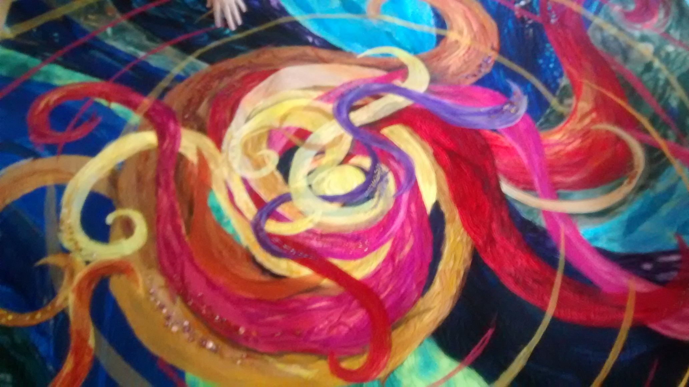
Dynamic and interconnected-A photo of a portion of a fabric hanging by Clare Atwell

Slide 6
Where concept is observed:
Indigenous practises - on all continents
Aristotle – value in use, value in exchange
Roman Law
Magna Carta
Notes:
Based on very old forms of human customs and agreements: In early Roman law, the Justinian code…”by law of nature these things are held in common…the air, running water the sea and shorelines”…..
Magna Carata also maintaining relationship of people and the resources they depend on for survival is part of the magna Carta. According to those customs, governments role was to support this relationship, not privatize it for use of some at the exclusion of others.

Slide 7
Commons Gifts or “Resources” can refer to:
Naturally Occurring Water Forests Minerals Soil Oceans Atmosphere | Human Created Culture Language Knowledge Institutions Inventions Internet

Slide 8
Local, Regional, Global
Abundant or Scarce
Renewable or Depletable

Slide 9
Natural developmental relationships
amongst systems
is a nested hierarchy -
but it has become reversed

Slide 10
Economic
Systems
Social Systems
Earth Systems
Universal Systems

Slide 11

Governance
and Economic
Systems
Social Systems
Earth Systems
Universal Systems

Slide 12
Destruction of Commons has occurred through:
Enclosures
Privatization
Commodification
Individualism
Scarcity Pricing
Wage Labour

Slide 13



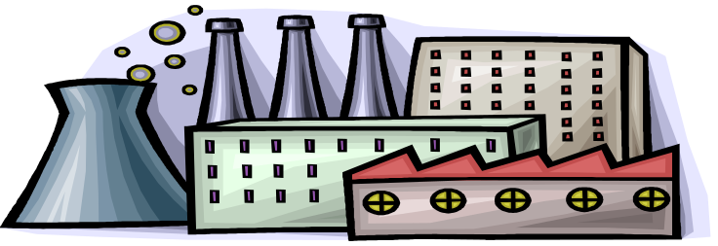

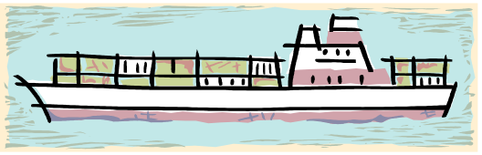
Government
(public)
Economics
(private)
Civil society
When public is taken over by private who is caring for the commons???

Slide 14
Climate Change
No one is caring for the Atmosphere Commons
and Ocean Commons
Being used as a free dump- an “externality” with no regard for costs to current and future generations and other species

Slide 15
UN Negotiations
Dilemmas of the global commons - managing individualism
“Free Riders”: why pay if you can ride for free
“You are a Sucker”: if you pay when others are getting away with a free ride.

Slide 16
Importance of limiting free riding:
Fee on pollution (carbon pricing)
Distribute revenue to commoners (fee and dividend)
Impose legal accountability for damage – Climate Law in our Hands
Local Management and regulation

Slide 17
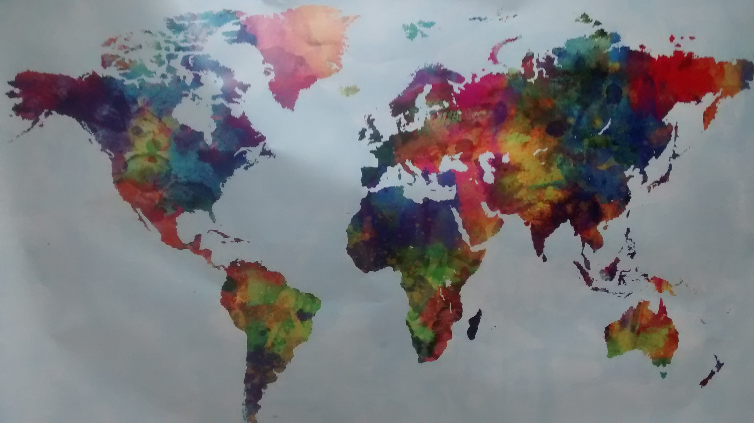
Jan Inglis commonstrust@gmail.com

